Slide 1

SRI SIDDHARTHA INSTITUTE OF TECHNOLOGY
Project seminar on
“Gesture Controlled Robot Using Sixth Sense Technology”
PRESENTED BY:
HARSHITHA GL | (15EC022)
HEMAVATHI B | (15EC025)
NITISH KUMAR | (15EC056)
SAQIB MEHMOOD BHAT | (15EC079)
Under the Guidance of
Mrs. Manjula Y
Assistant Professor, Dept. of ECE,
SSIT, TUMKUR

Slide 2
CONTENTS
Introduction
Literature Survey
System Design
Hardware and Software Description
System Design Implementation
Results
Applications
Advantages and Disadvantages
Conclusion
References

Slide 3
INTRODUCTION
Sixth sense is an “Extra Sensory Perception” which is not perceived by any of our five natural senses.
A gesture is a form of non-verbal communication.
A gesture controlled robot is a kind of robot that can be controlled by using your hand gestures.

Slide 4
Instead of using a remote control with buttons or a joystick, the gestures of the hand are used to control the motion of the robot.
The project is based on wireless communication, where the data from the hand gestures is transmitted to the robot.
This project based on hand controlled system, is developed using an mechanical arrangement controlled by a Programmable Interface Controller

Slide 5
The objective of this project is to create a gestured controlled robot using sixth sense technology which works on the principles of gesture recognition and image processing.
Controlling a robot with ease just by the help of coloured caps worn on the fingertips of the user.
OBJECTIVE
The key motivation of this project came by seeing the struggle of disabled people in moving from one place to another and by an incident in which my car was stuck in between two cars and I was not having any access to my vehicle and spent a lot of time looking for their owners.
MOTIVATION

Slide 6
Our five natural senses are used to analyse and modify the information from our surroundings. But the information which is in digital form are still untouched.
Still we don’t have any device which gives the direct link between the digital world and our physical interaction with the real world.
PROBLEM DOMAIN
This prototype based on sixth sense technology concept is an effort to connect the data in the digital world into the real world.
SOLUTION TO THE PROBLEM

Slide 7
LITERATURE SURVEY
PAPER NO | TITLE | AUTHOR NAME | YEAR OF PUBLICATION | DESCRIPTION
Paper-1 | “A Study on Sixth Sense Technology” | Ajesh M.S., Subin P Sabu, Ms. Mintu Movi | Volume 8, 5th May 2017 | This paper helps us to understand how the sixth sense device has overpowered the five natural senses. They also implemented an invisible computer mouse that enables interaction with computer without attaching a hardware mouse.
Paper-2 | “Design of Robotic Arm based on Hand Gesture Control System using Wireless Sensor Networks” | R.Raja Prabhu, R.Sreevidya | Volume 4, 3rd March 2017 | This paper focuses on design of a hand gesture control robotic arm using microcontroller with the help of zigbee and wireless sensor networks. It used flex sensors which are mounted on each joints of all five fingers which sends the data wirelessly using zigbee protocol for robot motion.

Slide 8
Paper-3 | “MATLAB based Gesture Controlled Robot” | Mukti Yadav, Mrinal Yadav, Hemant Sapra | Volume 3, January-March 2016 | This paper had proposed automatic gesture control using MATLAB which uses Bluetooth Module as a wireless medium through which PC and Robot are connected. Here two types of interfaces are created i.e. human PC interface and PC robot interface.
Paper -4 | “DRAG AND DROP: Data Transfer between Two Digital Devices” | Sachi Rana, Mr, Mohammed sayeemuddin Shaikh, Prof. Sanjay D Joshi. | Volume 2, 2nd February 2015 | The paper explores various approaches of transmitting data between different digital devices through which we can connect real physical world to digital world.
Paper -5 | “A Step Towards Smart City Using Sixth Sense Technology” | Dr. A. Sumithra, K. Karthika, J. Jane Ida | Volume 3, 9th September 2015 | The paper uses the evolution of sixth sense technology which later on developed into an augmented reality. This paper primarily focuses on the existing system and the proposed system. The paper also proposes the idea of future work development i.e. the concept of intelligent traffic system.

Slide 9
SYSTEM DESIGN
TRANSMITTER SIDE
RECEIVER SIDE
ROBOT MOTION
CAMERA
MICRO CONTROLLER
LAPTOP
WIRELESS COMMUNICATION
Zigbee TX
Electrical to EM energy conversion
Zigbee RX
EM to Electrical energy conversion

Slide 10
HARDWARE REQUIREMENTS
PIC18F45K22 Microcontroller
Motor Driver L293D
DC Motor
Zigbee Module
Camera
Laptop/Personal Computer
Coloured Markers
SOFTWARE REQUIREMENTS
Mikro C PRO
MATLAB

Slide 11
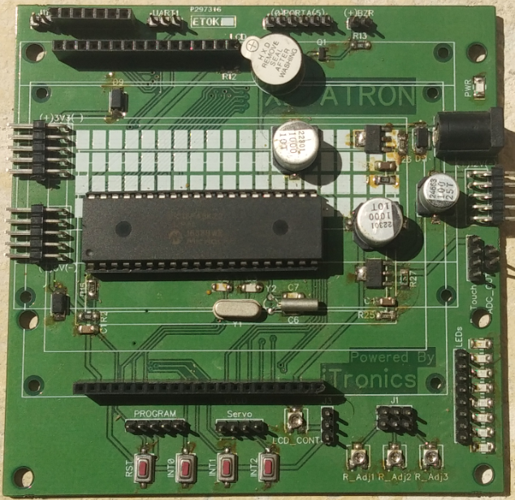
PIC18F45K22 Development Board
High Performance RISC CPU.
Upto 1024 bytes of Data EEPROM.
Two Master Synchronous Serial Port.
16MHz Internal Oscillator Block
Two Enhanced Universal Synchronous Asynchronous Receiver Transmitter.
Analog to Digital Converter (ADC) module of 10 bit resolution, upto 30 external channels.
3-wire SPI (Serial Peripheral Interface).

Slide 12
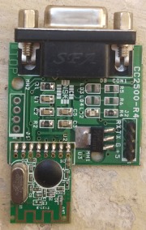
Zigbee Module
It is an IEEE 802.15.4 standard ,suited for high level communication protocols.
The technology defined by the Zigbee is intended to be simpler and less expensive.
Zigbee protocols are meant for embedded applications requiring low power consumption.
Its transmission distance ranges from (10-100)meters.
Data transmission rate ranges from (20-250)Kbits/sec.
The Zigbee protocol operates globally on a single frequency of 2.4GHZ.

Slide 13
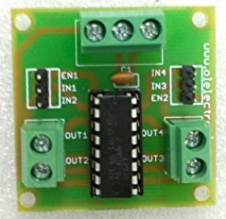
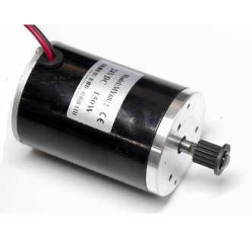
Motor Driver L293D
It has four i/o pins.
All these four pins are connected to the digital pins of microcontroller and four o/p pins are connected to DC motor of a robot.
DC Motor
It is mechanically commutated electric motor powered from direct current.
It is used to convert DC electrical energy into mechanical energy.
It is better suited for the equipment ranging from 12V DC system which require fine speed contol for a range of speeds above and below the rated speeds.

Slide 14
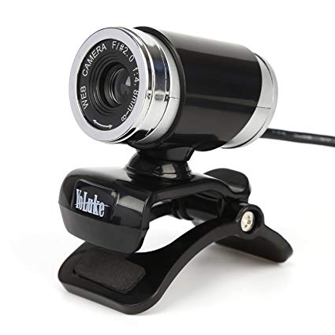
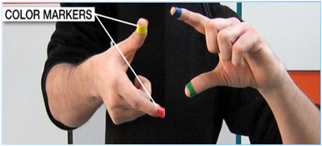
Camera
Captures the objects in view and track the users hand gestures
It sends Data to the Laptop
It acts as a Digital eye connecting us to the world of digital Information
Coloured Markers
It is at the tip of user’s fingers.
Marking the user’s fingers with red, yellow, green or blue tape helps the webcam to recognize the gestures.

Slide 15
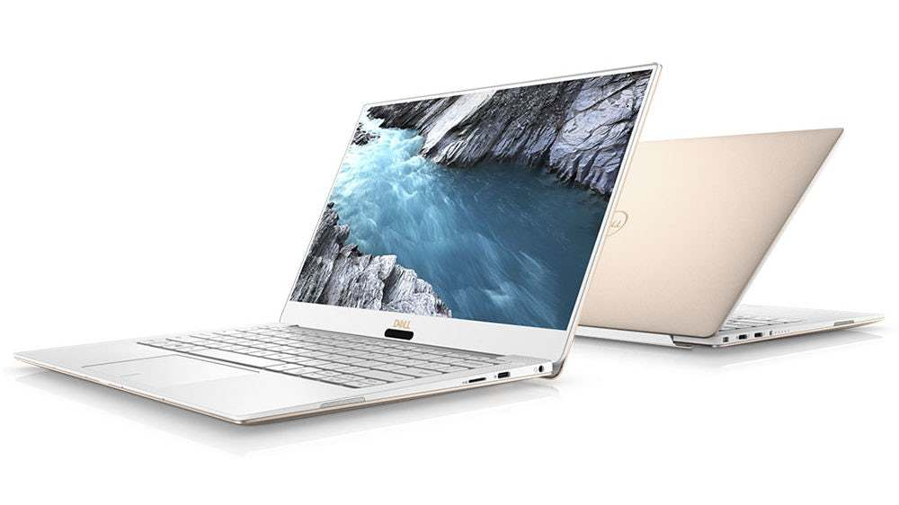
Laptop or Personal Computer
It is used as the processing device that processes the input video data send by the camera.
It is also used for running or implementing the code written on the MATLAB tools for executing the concept of image processing.

Slide 16
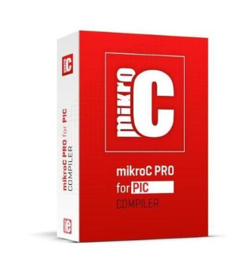

mikroC PRO
The mikroC PRO for PIC is a full-featured ANSI C compiler for the PIC devices from Microchip.
It is the best solution for developing code for PIC devices.
It features intuitive IDE, powerful compiler with advanced optimization, lots of hardware and software libraries and additional tools that helps in the completion of our work.
MATLAB
MATLAB has Image Processing Toolbox which provides a comprehensive set of reference-standard algorithms and workflow apps for image processing.
Image acquisition, Image segmentation, enhancement, noise reduction, geometric transformation, etc, can easily be performed using MATLAB.
Acquiring and Importing images and videos generated by a wide range of devices including webcams, digital cameras, etc. are done with MATLAB.

Slide 17
SYSTEM DESIGN IMPELMENTATION
START
Interface the camera with MATLAB and acquire the image/video having gestures.
Detect and recognize the gestures.
Perform the respective real time actions.
STOP

Slide 18
Steps in System Implementation
Image Acquisition
RGB to Grayscale conversion
Extraction of colour
Gray to Binary scale conversion
Finding centroid of the image
Serial communication between MATLAB and Computer.

Slide 19
Control flow block diagram
Camera
Capturing gestures movement
Extracting colours from the markers
Object detection
Image Processing at control Station
Command detection
Micro controller
Zigbee module
Motor driver
Robot motion

Slide 20
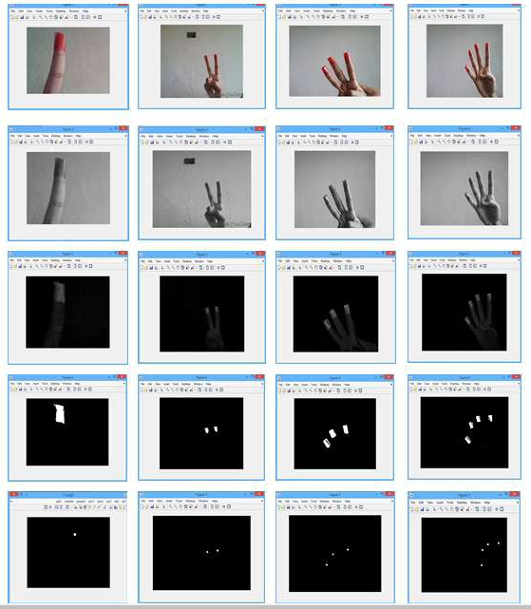
Object Extraction Results
RESULTS

Slide 21
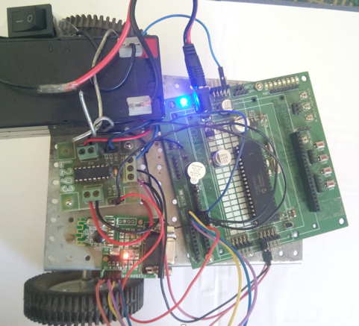
Snapshot

Slide 22
Algorithm to get the Results
Step 1: Acquiring Image from camera.
Step 2: Converting RGB to Grayscale Image.
Step 3: Extracting the required coloured from the original Image
Step 4: Setting threshold for the extracted image.
Step 5: Converting grayscale image to binary image.
Step 6: Setting Centroid for the binary Image to get the Object.
Step 7: Transmitting the obtained object wirelessly through a zigbee module to the microcontroller.
Step 8: Microcontroller controls the movement of the robot.

Slide 23
Command Detection
OBJECT DETECTED | ROBOT MOTIONS
No Object | Stops
One Object | Forward
Two Objects | Backward
Three Objects | Left turn
Four Objects | Right turn

Slide 24
ADVANTAGES
One of the main advantages of this prototype device is its small size and portability.
The data access through recognition of hand gestures is much easier and user friendly to the text user interface or graphical user interface which requires keyboard and mouse.
The technology has a user guide that can be used very simply.
Gestures can be used to control interactions for entertainment purposes such as gaming to make the game player’s experience more interactive or immersive.
Through the use of gesture recognition, remote control with the wave of a hand of various devices is possible.
The cost incorporated for the construction of sixth sense prototype is low and accessible by common people.

Slide 25
DISADVANTAGES
It will undoubtedly lead to technology addiction as excessive use of technology has already been affecting social lives.
Night vision camera has to be used in darker regions, this might make the technology quite expensive.
Coloured finger caps has to be used for creating an object.

Slide 26
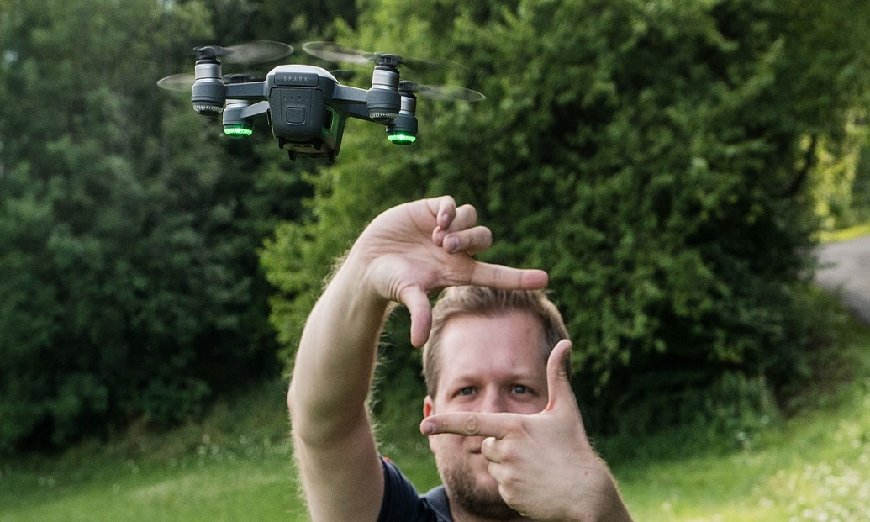
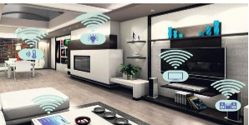
APPLICATIONS
Taking Pictures
Home Automation

Slide 27
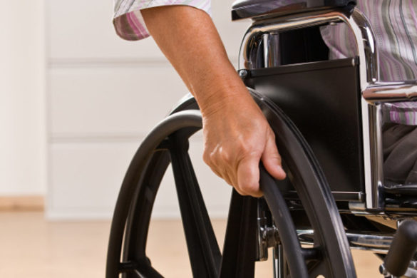
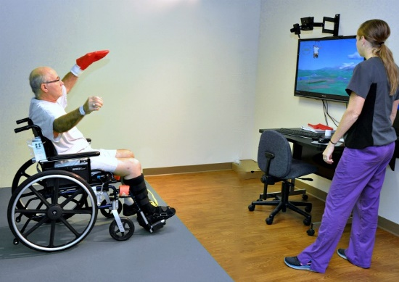
Improvise the Life of Disabled people.

Slide 28
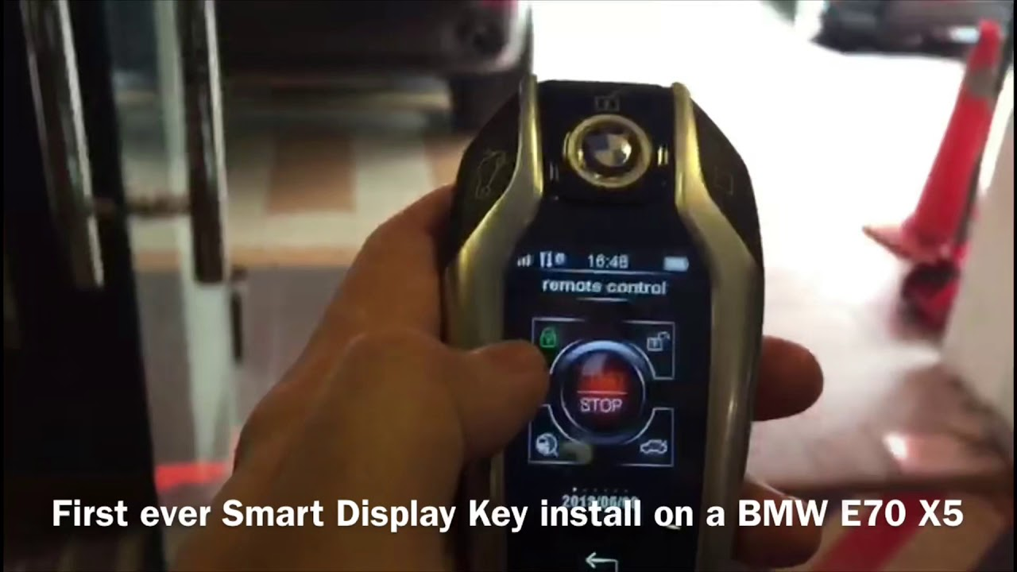

Slide 29
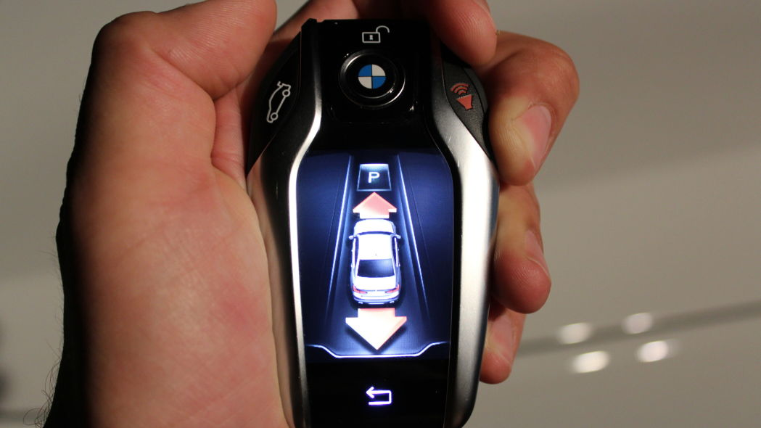
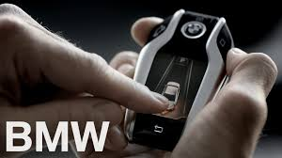
Can replace one of the features of advanced Display key invented by BMW.

Slide 30
CONCLUSION
This proposed method has huge potential because of the optimise approach of Sixth Sense Technology. In this project Image Processing algorithms are implemented for identification of the object and further those objects act as a command which is sent to microcontroller wirelessly through a zigbee module. Certain improvisations can be done in the wheelchair to make it reachable to the people in need and it can completely replace one of the features of the advanced display key with its technology.

Slide 31
REFERENCES
Shailaja Udtewar, Joesh J. Noronha, Yash A. Chheda, “Advanced AR-Augmented Reality using Sixth Sense Technology” International Journal of Engineering Science and Computing, volume: 6 Issue: 5, May 2016.
D.S. Patil, Shahak Patil, “Sixth Sense Technology-A new Innovation” International Journal on Recent and Innovation Trends in Computing and Communication, volume: 2, Issue: 5, May 2014.
Sidharth Rajeev, “Seventh Sense Technology”, 2015 IEEE UP Section conference on Electrical Computer an Electronics (UPCON).
A. Sumithra, K.karthika, J. Jane Ida, “A Step towards Smart city using Sixth Sense Technology”, International Journal of Research in Computer Applications and Robotics, volume: 3, Issue: 9, September 2015.
Akhilesh Waoo, Subhashish Das, “Empowerment of Digital World using Sixth Sense Technology”, American Association for Science and Technology (AASCIT), volume: 4, Issue: 6, August 2.

Slide 32
THANK YOU ANY QUESTIONS?

